Slide 1
Statewide Analysis of Bicycle Crashes in North Carolina
Prepared By:
Matt Dardari
Preethika Gajendran
Rashi Waghray

Slide 2
Project Objectives
WHAT?
Study Bicycle Crashes in North Carolina
Identify when most fatal crashes occur
WHEN?
Identify where most fatal crashes occur
WHERE?
Analyze who are involved in the most fatal crashes
WHO?
Identify and analyze causes for fatal crashes
WHY?
Understand how fatal crashes can be avoided
HOW?

Slide 3
Bicycle Crash Analysis – WHAT?
OBJECTIVE: Study statewide bicycle crashes in North Carolina from Jan 2007-Dec 2018
DATASET USED: https://www.chapelhillopendata.org/
WHAT’S INCLUDED IN THE DATASET:
Police-reported bicycle collisions with pedestrians and motor vehicles
Crashes occurred on:
the public roadway network
public vehicular areas
private properties (if reported)
EXCLUSIONS / LIMITATIONS
Identification numbers
Fatality information
Protective gear information

Slide 4
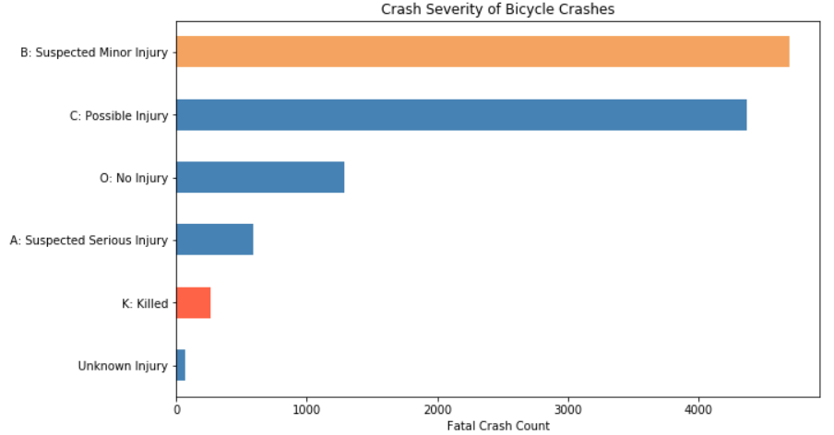
Bicycle Crash Analysis – WHAT?
TOTAL CRASHES – 11266
CRASH SEVERITY ANALYSIS:
Minor Injuries – 4696(42%)
Possible Injuries – 4369(39%)
No Injury – 1283(11%)
Serious Injury – 589(5.23%)
Killed – 259(2.3%)
Unknown – 70(0.62%)
FATALITY ANALYSIS:
TOTAL FATAL CRASHES – 259
Crashes resulting in the death of a biker – 250
Crashes resulting in the death of a motorist – 2
Crashes resulting in the death of a pedestrian – 7

Slide 5
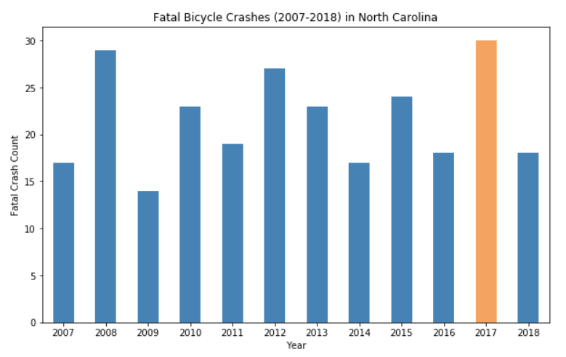
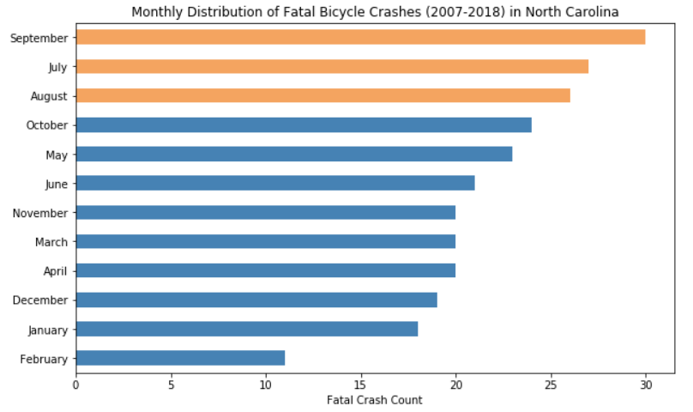
Bicycle Crash Fatality Analysis – WHEN?
YEARLY TREND:
Most fatal crashes 30(12%) occurred in 2017
Yearly Average = 22 fatal crashes/year
SEASONAL TREND:
Most fatal crashes 81(32%) occur in the summer months Jul – Sep

Slide 6
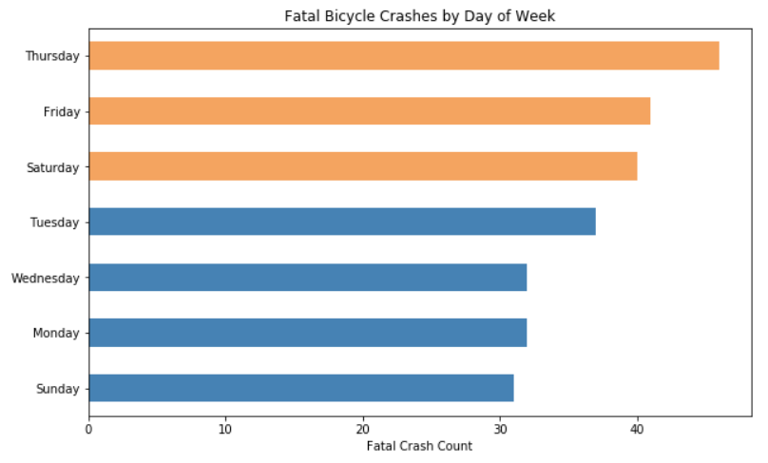
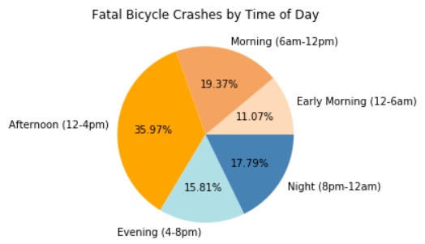
Bicycle Crash Fatality Analysis – WHEN?
DAY OF THE WEEK:
About half 127(49%) of the fatal crashes occur between Thursday-Friday-Saturday
TIME OF DAY:
More than a third of the fatal crashes 91(36%) occur in the afternoon (12-4pm)

Slide 7
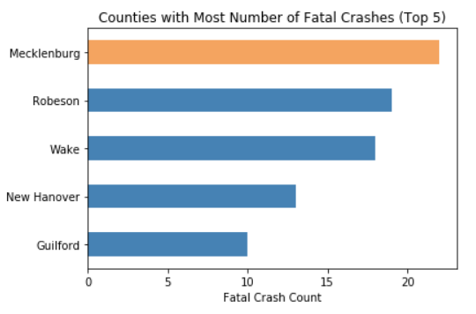
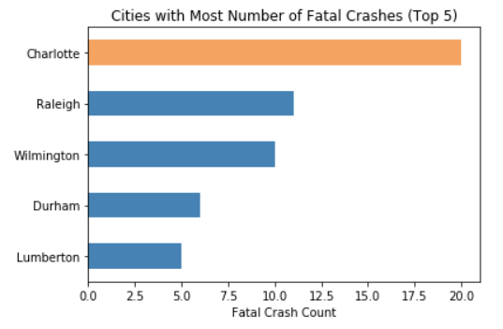
Bicycle Crash Fatality Analysis – WHERE?
COUNTY:
Mecklenburg county had the most fatal crashes 22(8.5%) in the state
CITY:
Charlotte had the most fatal crashes 20(8%) in the state

Slide 8
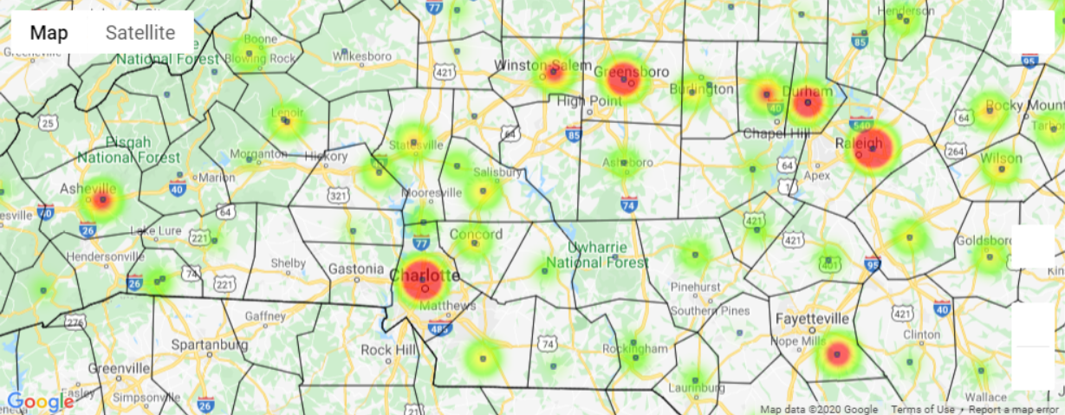
Bicycle Crash Analysis – COUNTY HOT SPOTS

Slide 9
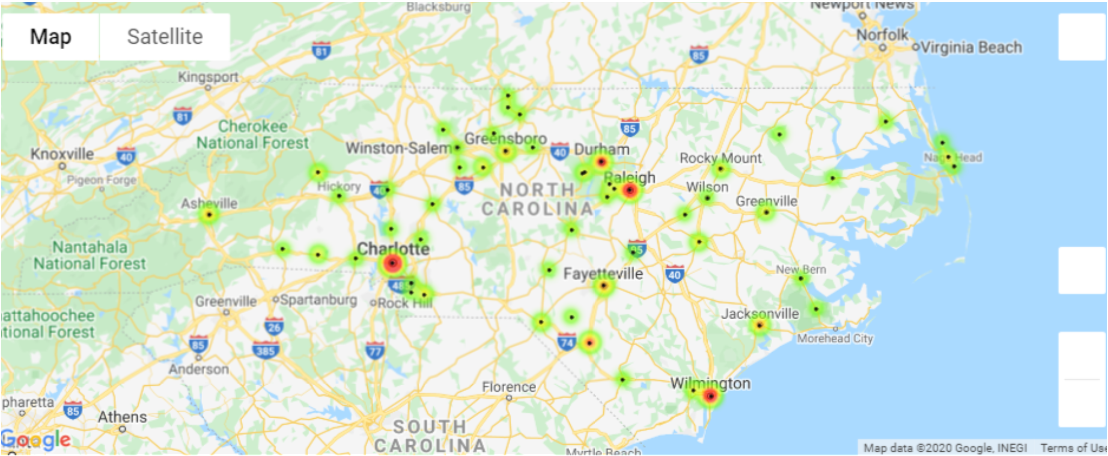
Bicycle Crash Fatality Analysis – CITY HOT SPOTS

Slide 10
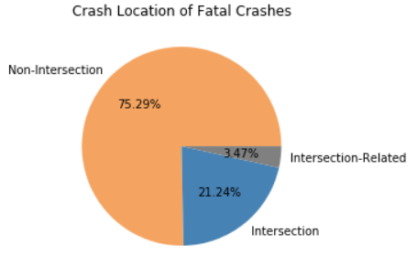
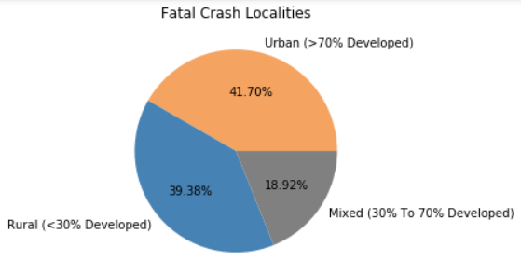
Bicycle Crash Fatality Analysis – WHERE?
LOCALITY:
Most fatal crashes 108(42%) occur in Urban Localities (>70% Developed) within the state
CRASH LOCATION:
Majority of fatal crashes 195(75%) took place at Non-Intersections

Slide 11
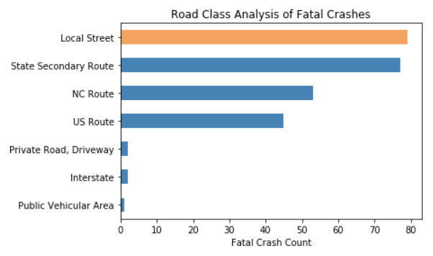
Bicycle Crash Fatality Analysis – WHERE?
ROAD CLASS:
About 79(30%) occurred on Local Streets within the state

Slide 12
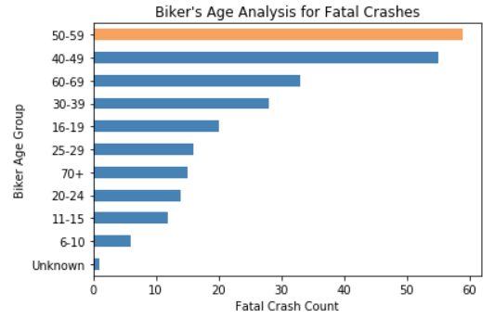
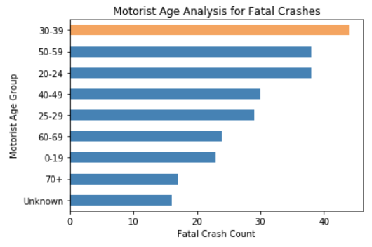
Bicycle Crash Fatality Analysis – WHO?
BIKER AGE:
Young Bikers (<20 years) – 38(15%)
Adult Bikers (20–60 years) – 172(66%)
Elderly Bikers (>60 years) – 48(19%)
MOTORIST AGE:
Young Motorists (<20 years) – 23(9%)
Adult Motorists (20–60 years) – 179(69%)
Elderly Motorists (>60 years) – 41(16%)

Slide 13
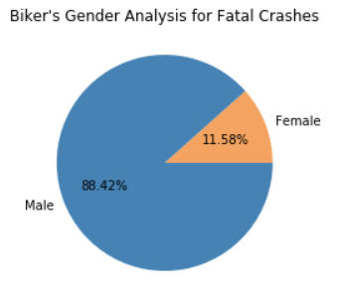
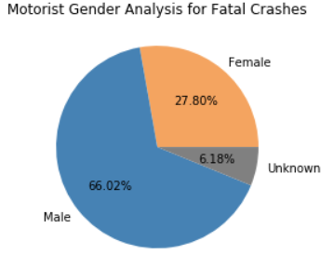
Bicycle Crash Fatality Analysis – WHO?
BIKER GENDER:
Majority of fatal crashes 229(88%) involved a male biker
MOTORIST GENDER:
Majority of fatal crashes 171(66%) involved a male motorist

Slide 14
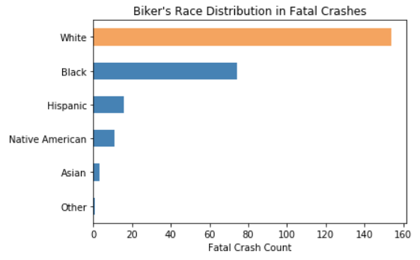
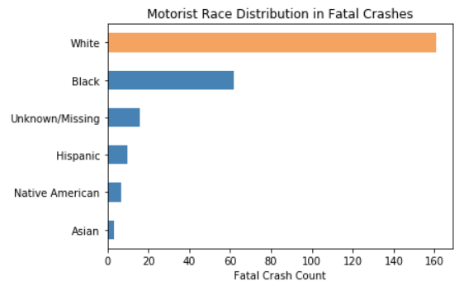
Bicycle Crash Fatality Analysis – WHO?
BIKER RACE:
Majority of the bikers 154(59%) involved in fatal crashes were Caucasians
MOTORIST RACE:
Majority of the motorists 161(62%) involved in fatal crashes were Caucasians

Slide 15
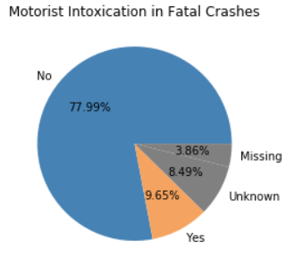
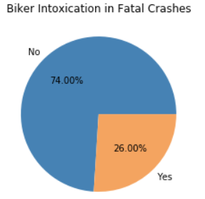
Bicycle Crash Fatality Analysis – WHO?
BIKER INTOXICATION:
3/4th of the fatal crashes 185(71%)* involved non-intoxicated bikers compared to 65(26%) intoxicated bikers
MOTORIST INTOXICATION:
3/4th of the fatal crashes 202(78%) involved non-intoxicated motorists compared to 25(10%) intoxicated motorists
*Data discrepancies exists in this analysis

Slide 16
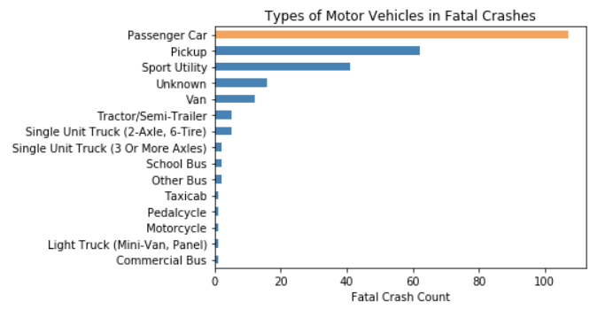
Bicycle Crash Fatality Analysis – WHO?
TYPE OF MOTOR VEHICLE:
In about 107(41%) of the fatal crashes, the bikers had collided with a motorist riding a Passenger Car

Slide 17
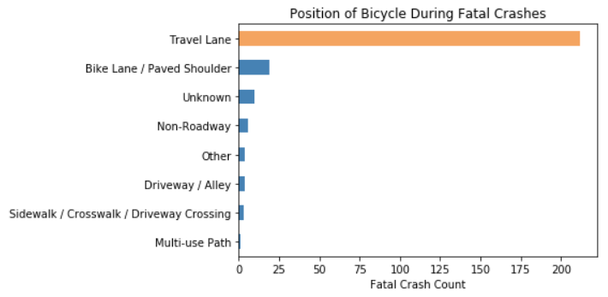
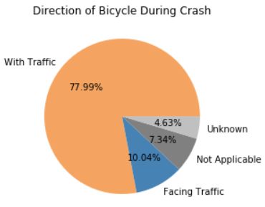
Bicycle Crash Fatality Analysis – WHY?
BICYCLE POSITION:
Majority of fatal crashes 212(82%) occurred when the biker was riding the bicycle in the travel lanes
BICYCLE DIRECTION:
Majority of fatal crashes 202(78%) occurred when the biker was riding the bicycle in the direction of the traffic

Slide 18
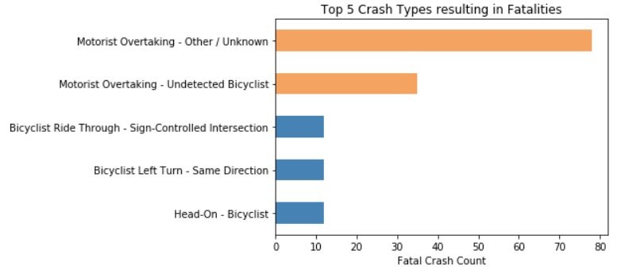
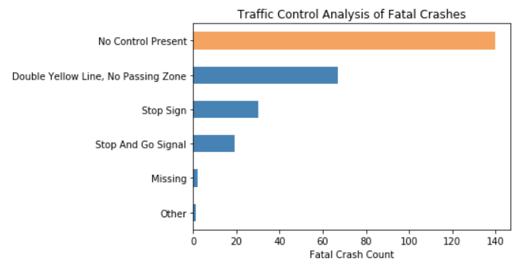
Bicycle Crash Fatality Analysis – WHY?
ACTION AT TIME OF CRASH:
About 113(44%) of the fatal crashes were due to a motorist overtaking the bicyclist
TRAFFIC CONTROL AT CRASH SITE:
There were no traffic control elements at the crash site for 140(54%) of the fatal crashes

Slide 19
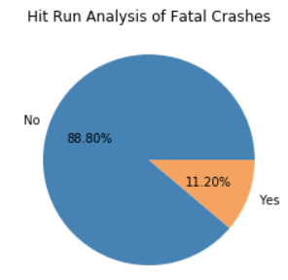
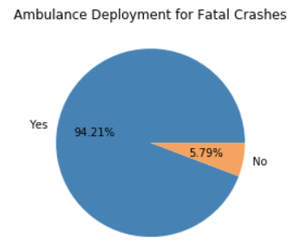
Bicycle Crash Fatality Analysis – WHY?
HIT AND RUN MOTORIST:
About 29(11%) of the fatal crashes were Hit and Run scenarios
AMBULANCE DEPLOYMENT:
An ambulance was deployed for 94% of the crashes that resulted in fatalities

Slide 20
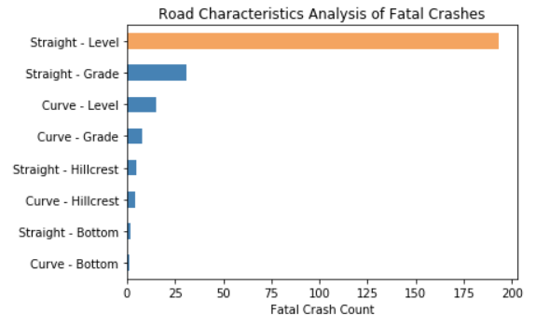
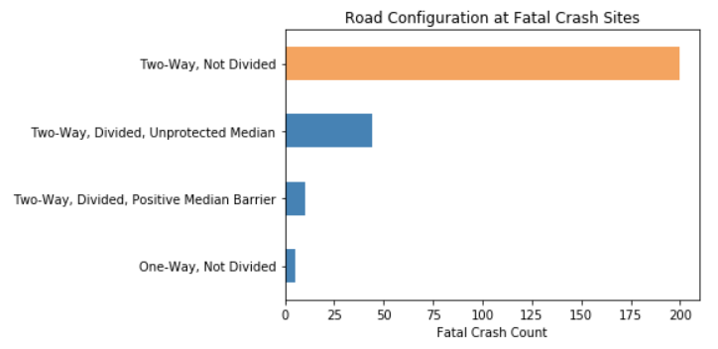
Bicycle Crash Fatality Analysis – WHY?
ROAD CHARACTERISTICS AT CRASH SITE:
3/4th of the fatal crashes 193(75%) occurred on Straight-Level roads
ROAD CONFIGURATION AT CRASH SITE:
3/4th of the fatal crashes 200(77%) occurred on Two-Way, Undivided roads

Slide 21
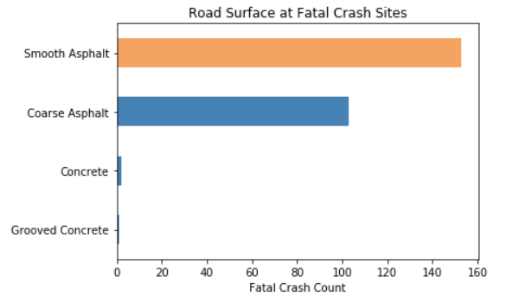
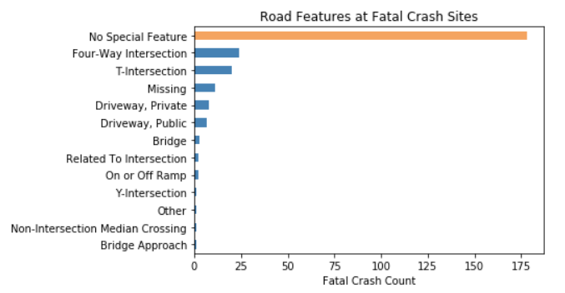
Bicycle Crash Fatality Analysis – WHY?
ROAD SURFACE AT CRASH SITE:
Most fatal crashes 153(59%) occurred on smooth roads made of Asphalt
ROAD FEATURES AT CRASH SITE:
There were no special features at majority of the fatal crash sites 178(67%)

Slide 22
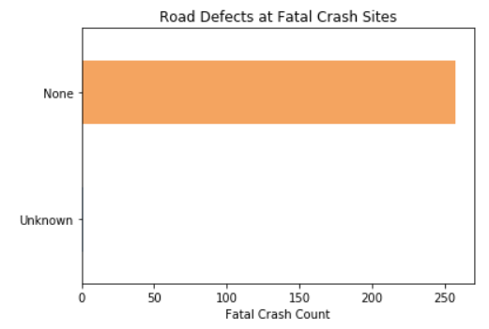
Bicycle Crash Fatality Analysis – WHY?
ROAD DEFECTS AT CRASH SITE:
There were no defects in the road at any of the fatal crash sites 258(99.7%)

Slide 23
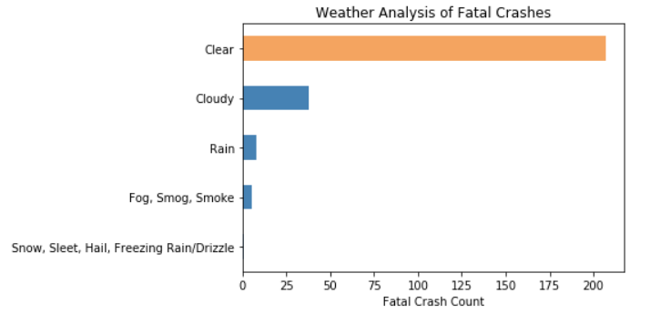
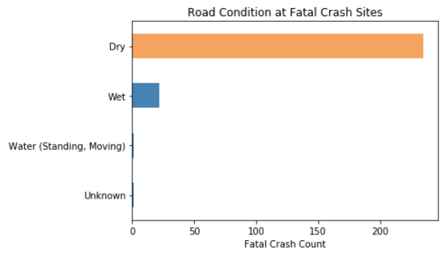
Bicycle Crash Fatality Analysis – WHY?
WEATHER CONDITION:
207(80%) of the fatal crashes occurred in clear weather
ROAD CONDITION:
235(91%) of the fatal crashes occurred on Dry roads

Slide 24
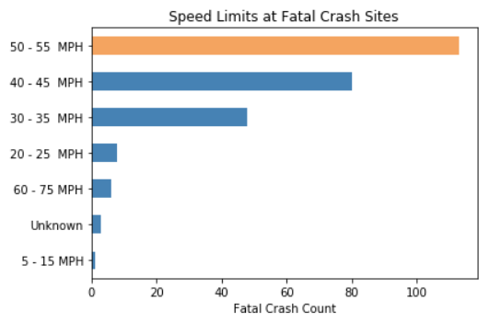
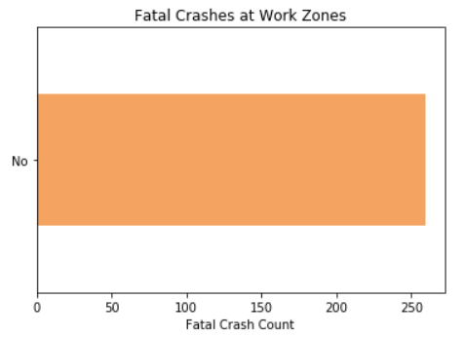
Bicycle Crash Fatality Analysis – WHY?
SPEED LIMIT AT CRASH SITES:
Majority of the fatal crashes 113(44%) occurred on roads with a speed limit of 50-55 MPH
WORK ZONES:
None of the fatal crashes 259(100%) occurred in work zones

Slide 25
Bicycle Crash Fatality Analysis – HOW?
You are more prone to be involved in a FATAL crash while riding a bicycle if you are:
male
caucasian
adult (20-60 years) of age
Your chances of getting into a fatal crash worsen if you:
go for a ride on a clear summer afternoon
on the local street
of an urban neighborhood
while travelling in the travel lane
of a two-way not-divided road
in the same direction as the traffic
with no traffic controls

Slide 26
Data Cleaning Processes Employed
Grouped similar values:
Crash Group
Road Conditions
Grouped items into categories / sub-categories (Binning):
Time of Day
Filtering values across rows and columns as required
Dropped unknown/missing/unwanted values as required
Renamed Column Headers

Slide 27
Next Steps
Analyze effect of the following on fatalities:
Use of helmets
Distracted Bikers/Drivers
Perform a study of non-fatal crashes
Perform correlation studies to identify interdependencies between various causes and factors

